Slide 1
Regulation of Proteasome Derived Antimicrobial Defense Peptides in Immune Cells during Infection
Maya Tallo, Wimeth Dissanayake, and Alex Roberts
Jax BDSiC 2026
Notes:
Hi everyone, my name is alex, this is wimeth and this is maya, and this is our presentation for the Jax BDISC program

Slide 2
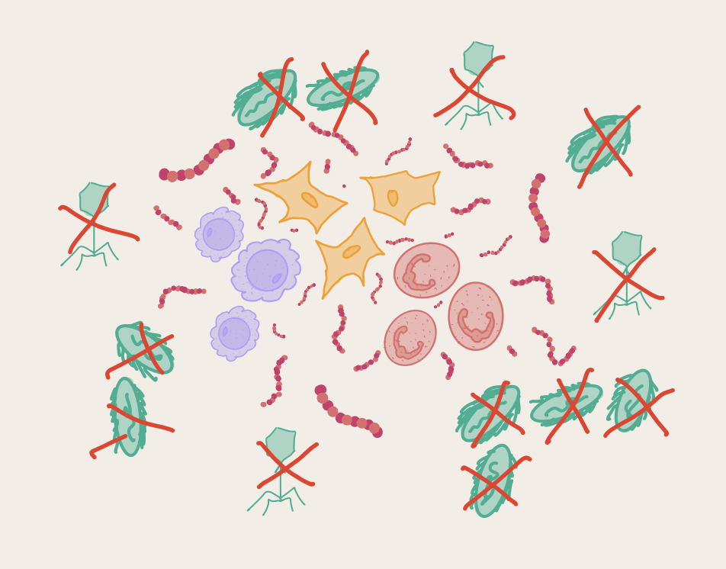
Antimicrobial Peptides are Versatile Tools for the Immune System
Target and kill various pathogens via membrane disruption or cellular process interference
Bacteria
Viruses
Parasites
Promote healing
Recruitment of immune cells (macrophages, lymphocytes)
Antimicrobial peptides
Jax BDSiC 2026
Notes:
What are Antimicrobial peptides. They are small peptides with defense properties against pathogens along with other abilities.
We don’t care about the text too much, reduce the paragraphs a bit + make the titles more story like (like the WHY/question to build on previous slides).

Slide 3
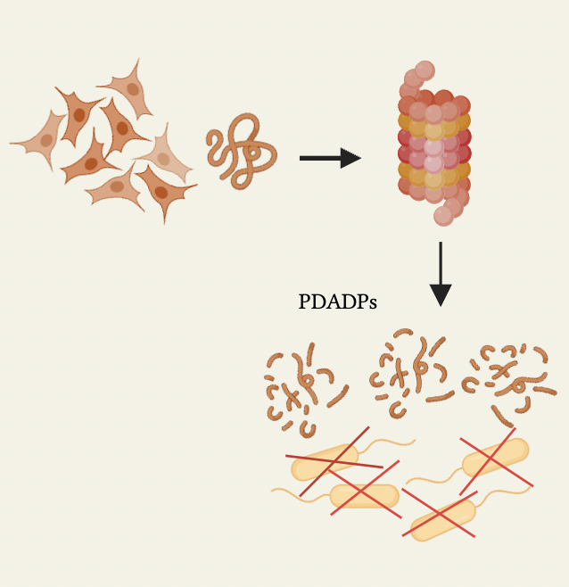
Where do Antimicrobial Peptides come from?
A newly discovered class of antimicrobial defense peptides, called Proteasomal Derived Antimicrobial Peptides (PDADPs), derived from the proteasome.
The Proteasome is a complex utilized by cells to break down and recycle proteins.
However, PDADPs show that the protein cleaving machinery of the proteasome can be co-opted for antimicrobial function as well.
A549 Adenocarcinoma cells
PDADPs
Jax BDSiC 2026
Notes:
A protein complex called the Proteasome breaks proteins down into peptides. However, Goldberg et al. discovered that the proteasome can also directly contribute to a cell’s antimicrobial response.

Slide 4
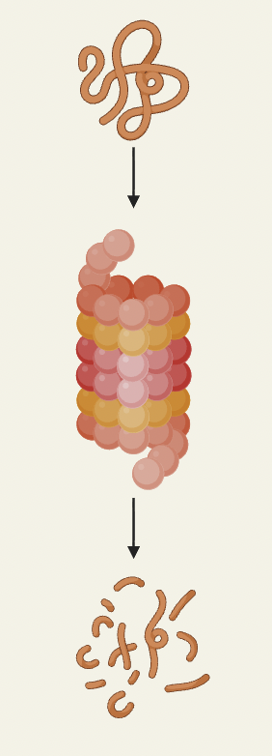
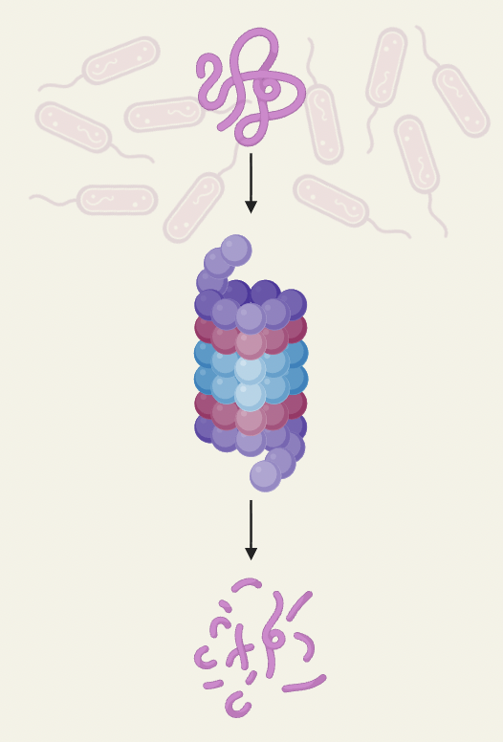
Do Other (Immune) Tissues form both Antigens and PDADPs?
PDADPs
Antigens
Immune cells already use the proteasome to process foreign proteins into antigens.
PDADPs are known to utilize specialized proteasome subunits, which differ from antigen forming proteasomes.
Can these different populations of proteasomes exist in the same tissues and cell types?
Jax BDSiC 2026
Notes:
Immune cells use a proteasome to change foreign proteins into antigens which can be recognized by T cells.
However, a different proteasome makes antimicrobial peptides, so can these different types of proteasomes exist in the same tissues and cell types?

Slide 5
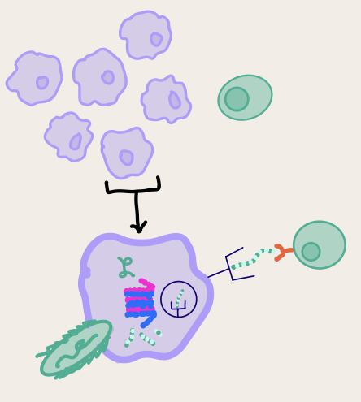
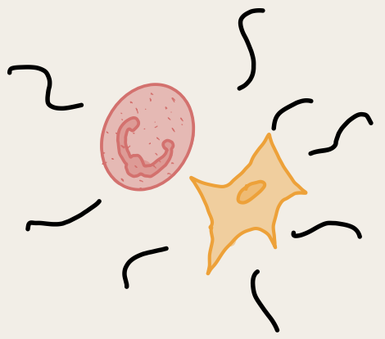
The Unique Problem of Antigen Presenting Cells
Professional APCs
Antigen presenting cells (APC) are immune cells that are able to process foreign proteins into antigens.
Professional APCs always express the antigen processing proteasome, so are always able to process foreign proteins.
Atypical APCs only express the antigen processing proteasome under certain cell conditions, often inflammation.
Atypical APCs
Jax BDSiC 2026
Notes:
Draw a cluster macrophage and a natural killer cell
Zoom a big macrophage, and in the cytoplasm draw a bacterial particle going in, going into proeosme, coming out as peptide
Binding to mHC protein, Going to surface, touching T cell

Slide 6
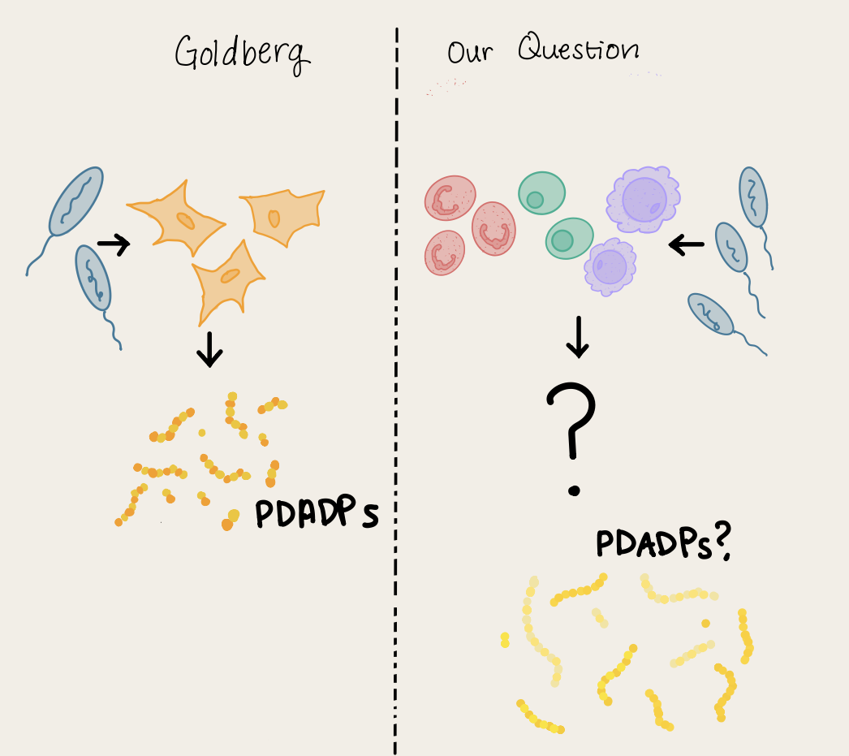
Specific Aims
- Are PDADP genes expressed in immune tissues during infection?
- How do PDADP genes correlate with specific genes and the antigen processing machinery?
- Do PDAPD genes show cell type specificity in immune tissues?
Jax BDSiC 2026
Notes:
Got data from a paper which investigated mice immune responses, and our analysis is on bulk-rna seq data of mice gene expression changes. We focused on genes which produce proteins that are precursors to PDAPDs to see if their expressions change from control to infected mice..
So with that in mind, these are the questions we investigated for our project

Slide 7
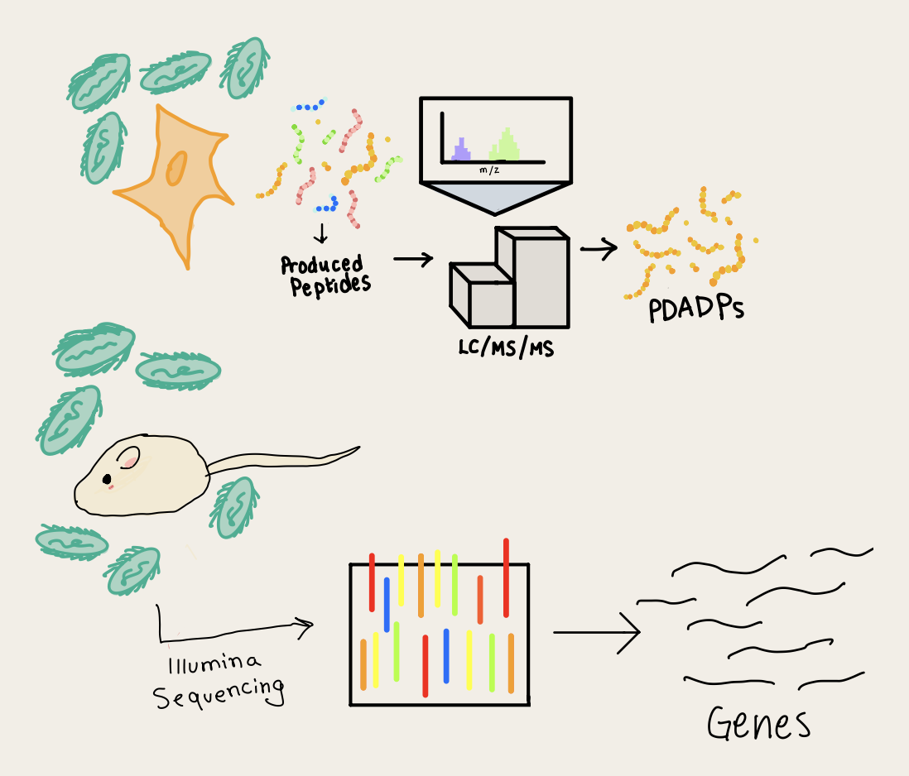
Dataset and Methodology
PDADPs were identified using a LC-MS derived proteomics dataset identifying peptides in A549 cells. (Goldberg et al., 2025)
Bone marrow tissue gene expression data was obtained from Bulk RNA-seq dataset produced from S.aureus infected mice.
Sequencing was performed via Illumina platform with 150-bp paired-end reads. (Lin et al., 2021)
Jax BDSiC 2026
Notes:
Got data from a paper which investigated mice immune responses, and our analysis is on bulk-rna seq data of mice gene expression changes. We focused on genes which produce proteins that are precursors to PDAPDs to see if their expressions change from control to infected mice..
So with that in mind, these are the questions we investigated for our project

Slide 8
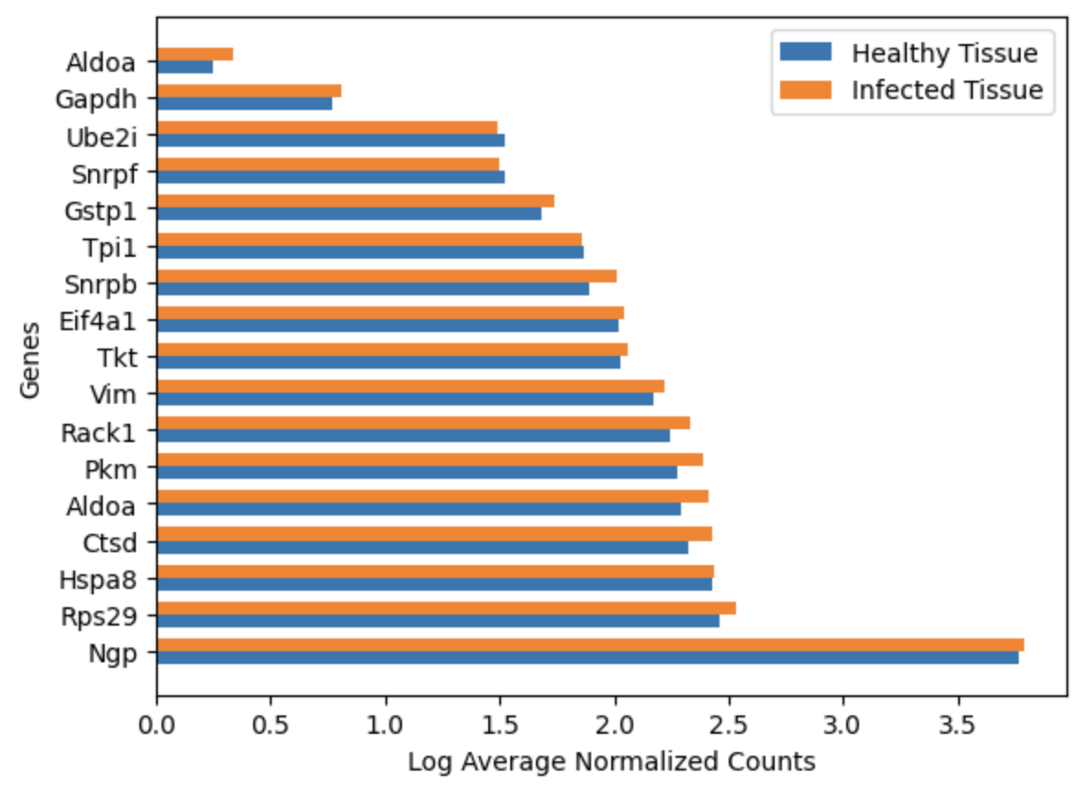
Are PDADP Genes Expressed in Bone Marrow (Immune) Tissue?
Positive Control:
Ngp = Neutrophilic Granule Protein Gene
Protein present in immune cells in high quantities
Jax BDSiC 2026
Notes:
Here we looked at the presence of the PDADP genes found in the Goldberg paper in the bone marrow tissue samples, with Neutrophilic granule protein being a positive control (a gene expressed in immune cells in high quantities). These plots show the log of the average normalized counts of the PDADP mRNA in healthy vs. infected tissue, and show that these genes are all present in both groupings of samples.

Slide 9
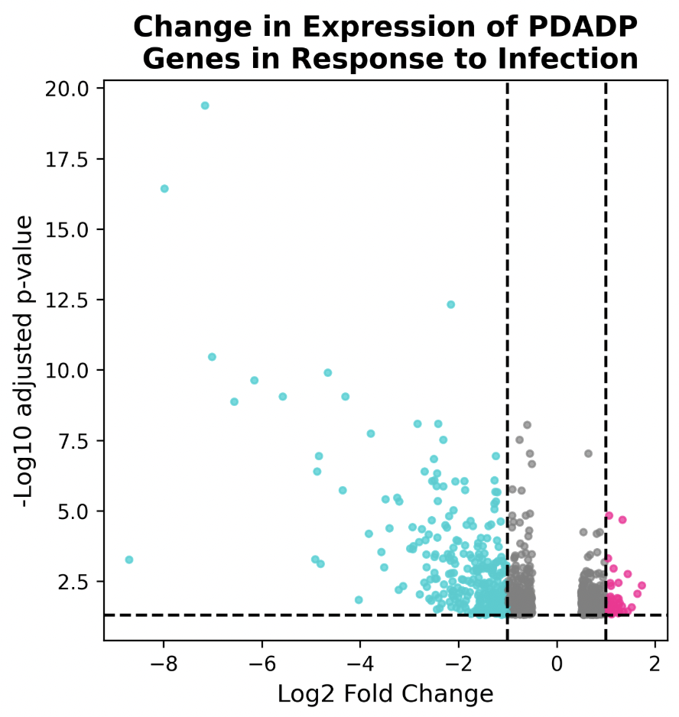
Upregulated
Downregulated
Insignificant
1.3
(p-value of 0.05)
Downregulated
Upregulated
Notes:
DESeq2 is a widely used R package in bioinformatics that identifies differentially expressed genes (DEGs) in RNA sequencing (RNA-seq) data, revealing which genes significantly change expression levels between different experimental conditions (e.g., treated vs. control). It works by normalizing count data, estimating gene-wise dispersions, fitting a negative binomial model, and performing statistical tests (like the Wald test) to find genes with significant expression changes, accounting for data variability
Here, we are comparing the PDADP gene expression in infected immune tissuto healthy immune tissue. All of our genes of interest were filtered out as insignificant. However, this doesn’t mean that the PDADPs are not active in the immune response of immune tissue– infection could still stimulate the proteasomal degradation of the proteins that result in these peptides.

Slide 10

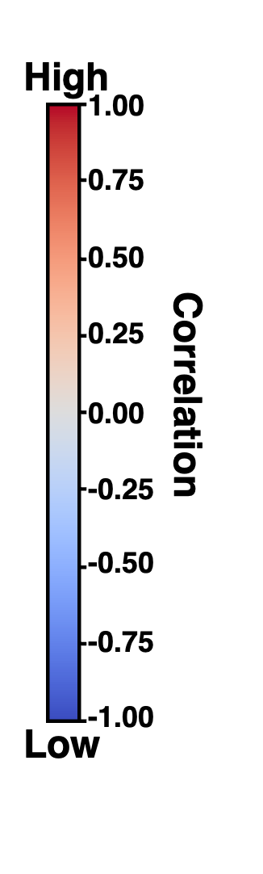
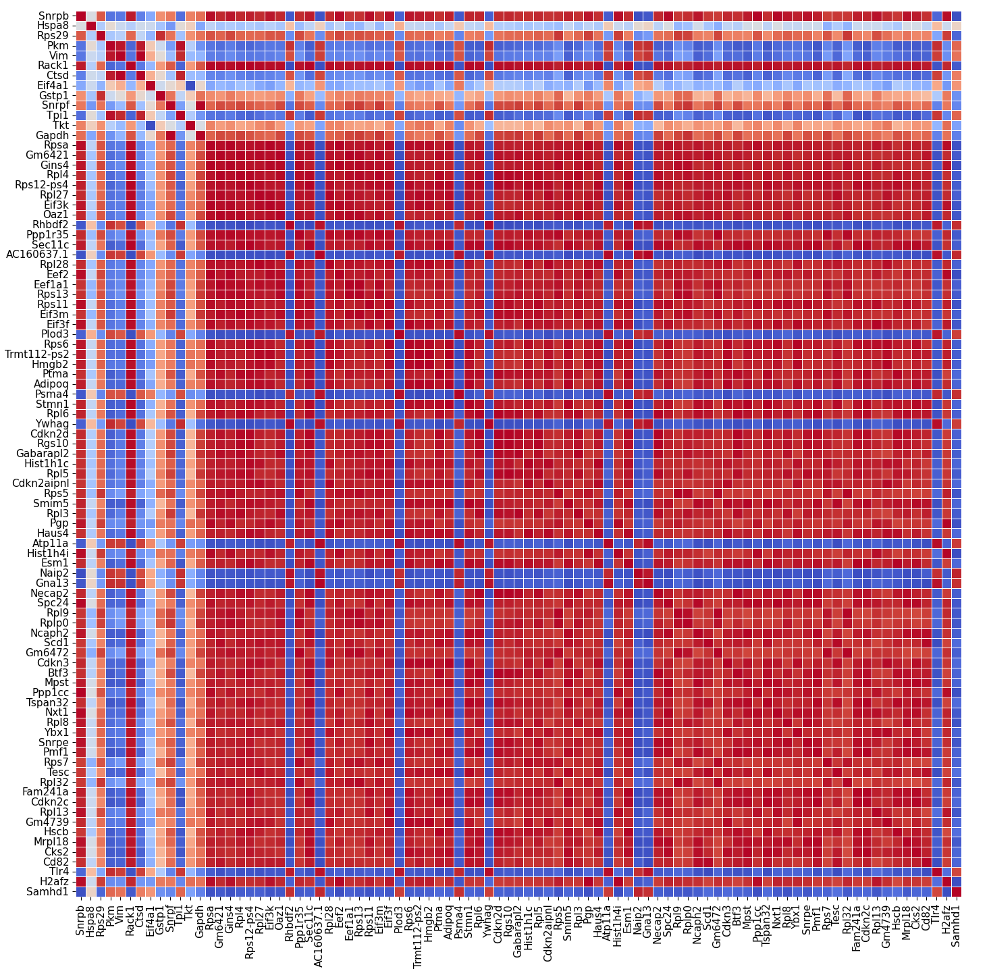

Genes Correlated with PDADP Expression can be Visualized by a Heatmap
Notes:
So the PDADP genes are present - what other genes do they interact with?
Looked at correlation of PDADP genes with all other correlated genes in our dataset. Gated for minimal count number and minimal correlation amount with our PDADP genes.
We visualized with a heatmap

Slide 11

Genes Correlated with PDADP Expression can be Visualized by a Heatmap
PDADPs show strong correlation with a subset of genes within bone marrow.
Heatmap shows correlation between expression of genes.
Notes:
Top left, we have PDADP genes, and all other are strongly correlated or anti-correlated genes within our dataset.
Red is high level of correlation, blue is high anti-correlation or no correlation.
We zoomed into left most column so x-axis is PDADP, and y is all the other correlated.

Slide 12
Genes Correlated with PDADP Expression can be Visualized by a Heatmap
PDADPs show strong correlation with a subset of genes within bone marrow.
Heatmap shows correlation between expression of genes.
Notes:
We zoomed into left most column so x-axis is PDADP genes, and y is all the other correlated genes.

Slide 13
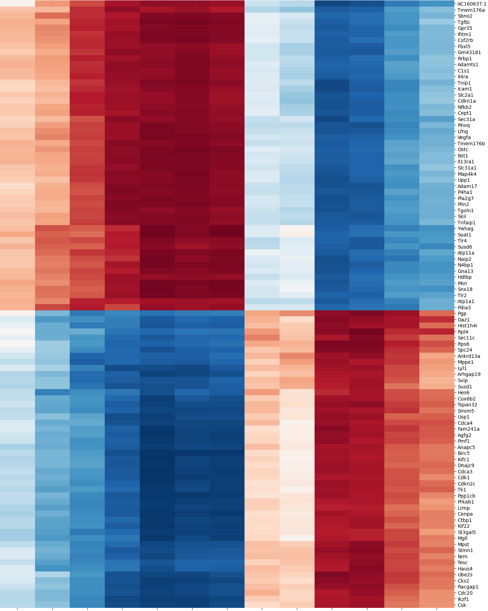

What PDADP Genes Coexpress with in Immune Tissues?
Vim
Tkt
Tpi1
Ctsd
Pkm
Snrpb
Snrpf
Rack1
Gstp1
Rps29
Hspa8
Eif4a1
Gapdh
Jax BDSiC 2026
Notes:
So the PDADP genes are present - what other genes do they interact with?
Looked at correlation of PDADP genes with all other correlated genes in our dataset. Gated for minimal count number and minimal correlation amount with our PDADP genes.
We visualized with a heatmap
We took this column and we sorted correlated genes and PDADP genes for similar coexpression, and this revealed two clusters of PDADP genes with roughly opposing gene correlation profiles.

Slide 14
PDADPs form Clusters that Coexpress with Different Genes
PDADP genes form 2 clusters:
Hspa8, Gstp1, Eif4a1, Ctsd, Tpi1, Vim, Pkm
Gapdh, Tkt, Snrpb, Rack1, Rps29, Snrpf
These clusters closely coexpress with a set of genes, including key immune regulators like Csf2rb, Icam1, and Tlr2/4 in cluster 1.
Vim
Tkt
Tpi1
Ctsd
Pkm
Snrpb
Snrpf
Rack1
Gstp1
Rps29
Hspa8
Eif4a1
Gapdh
Jax BDSiC 2026
Notes:
In this first cluster in yellow, the top set of genes is highly correlated with PDADP geness, while the bottom is highly anti-correlated. In the second cluster, the inverse is true – the top set of genes is strongly anti-correlated while the bottom site is highly correlated.
There are key immune regulators like Csf2rb, Icam1< and the Tlrs in Cluster 1. This made us wonder if we could identify different functions between the genes correlated with cluster 1 and cluster 2.

Slide 15
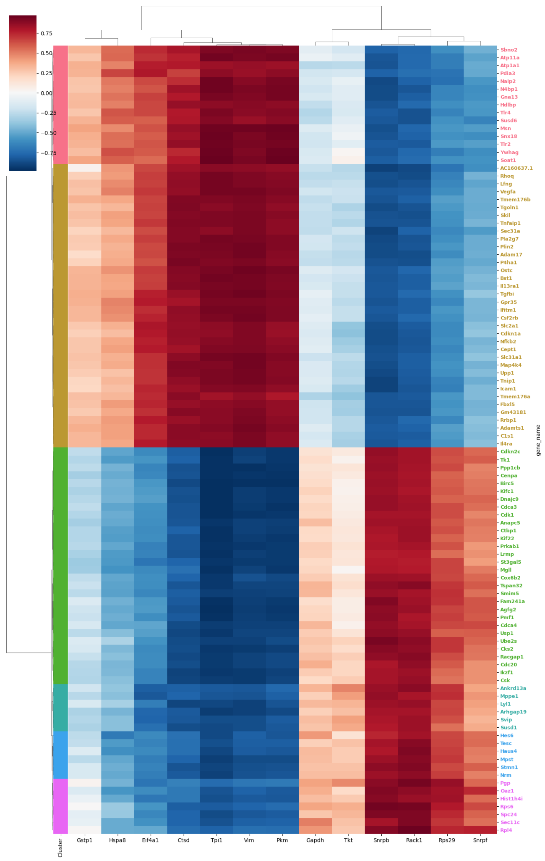
What are the Functions of PDADP Correlated Genes?
Ungrouped
Gene Ontology Analysis on strongly coexpressed genes show distinctions between PDADP cluster 1 and 2 correlated genes.
PDADP cluster 1 genes are closely correlated with genes involved in cell signalling.
PDADP cluster 2 genes are more closely correlated with cell cycle, and granulocyte differentiation genes.
Cell Signalling
Cell Cycle/Mitosis
Negative Regulation of ERAD
Granulocyte Differentiation
Translation
Tkt
Vim
Tpi1
Ctsd
Pkm
Snrpb
Snrpf
Rack1
Gstp1
Rps29
Hspa8
Eif4a1
Gapdh
Jax BDSiC 2026
Notes:
We ran GO, and the analysis revealed that while there were different functions between the genes associated with cluster 1 and cluster 2 genes
Cluster 1 is mainly associated with cell signaling, while cluster 2 is mainly associated with cell cycle and granulocyte differentiation.
These functional categories are quite broad and it does not tell us what the actual regulation of our cluster 1 and cluster 2 pdadp genes may be.

Slide 16
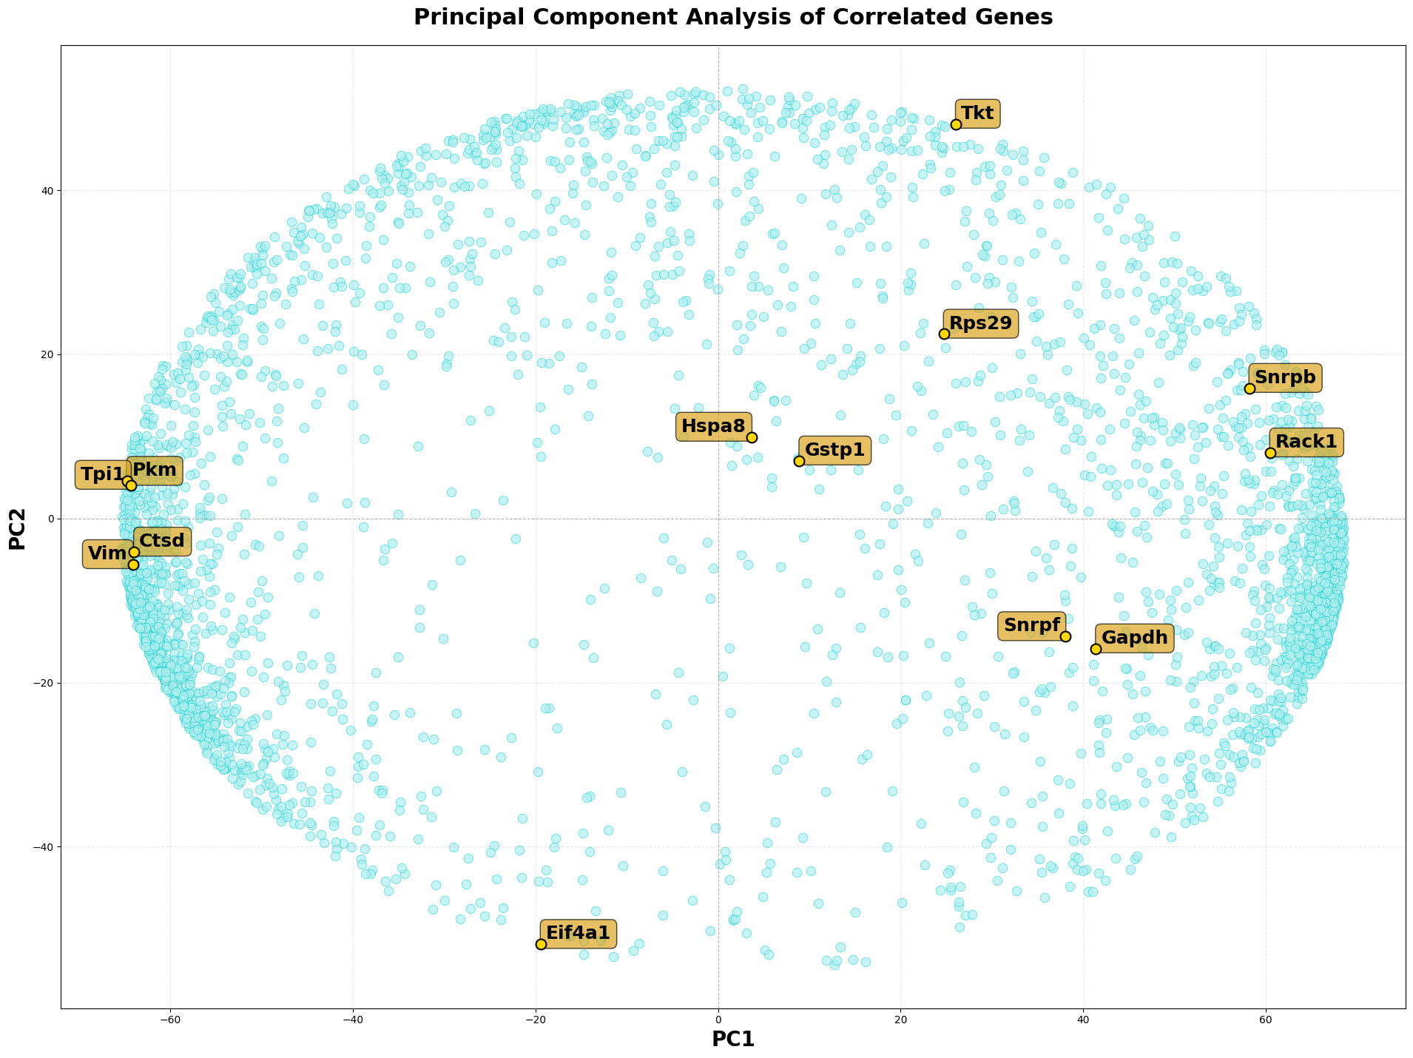
Principal Component Analysis can Map Gene Coexpression
Principal Component Analysis of PDADP Genes
PC1: 69.04%
PC2: 28.10%
Total: 97.14%
Principal component analysis allows for simplification of our all of our gene-gene correlations into two axes.
Graphed PDADP show paired clusterings (Tpi1, Pkm) indicating close correlation.
Jax BDSiC 2026

Slide 17
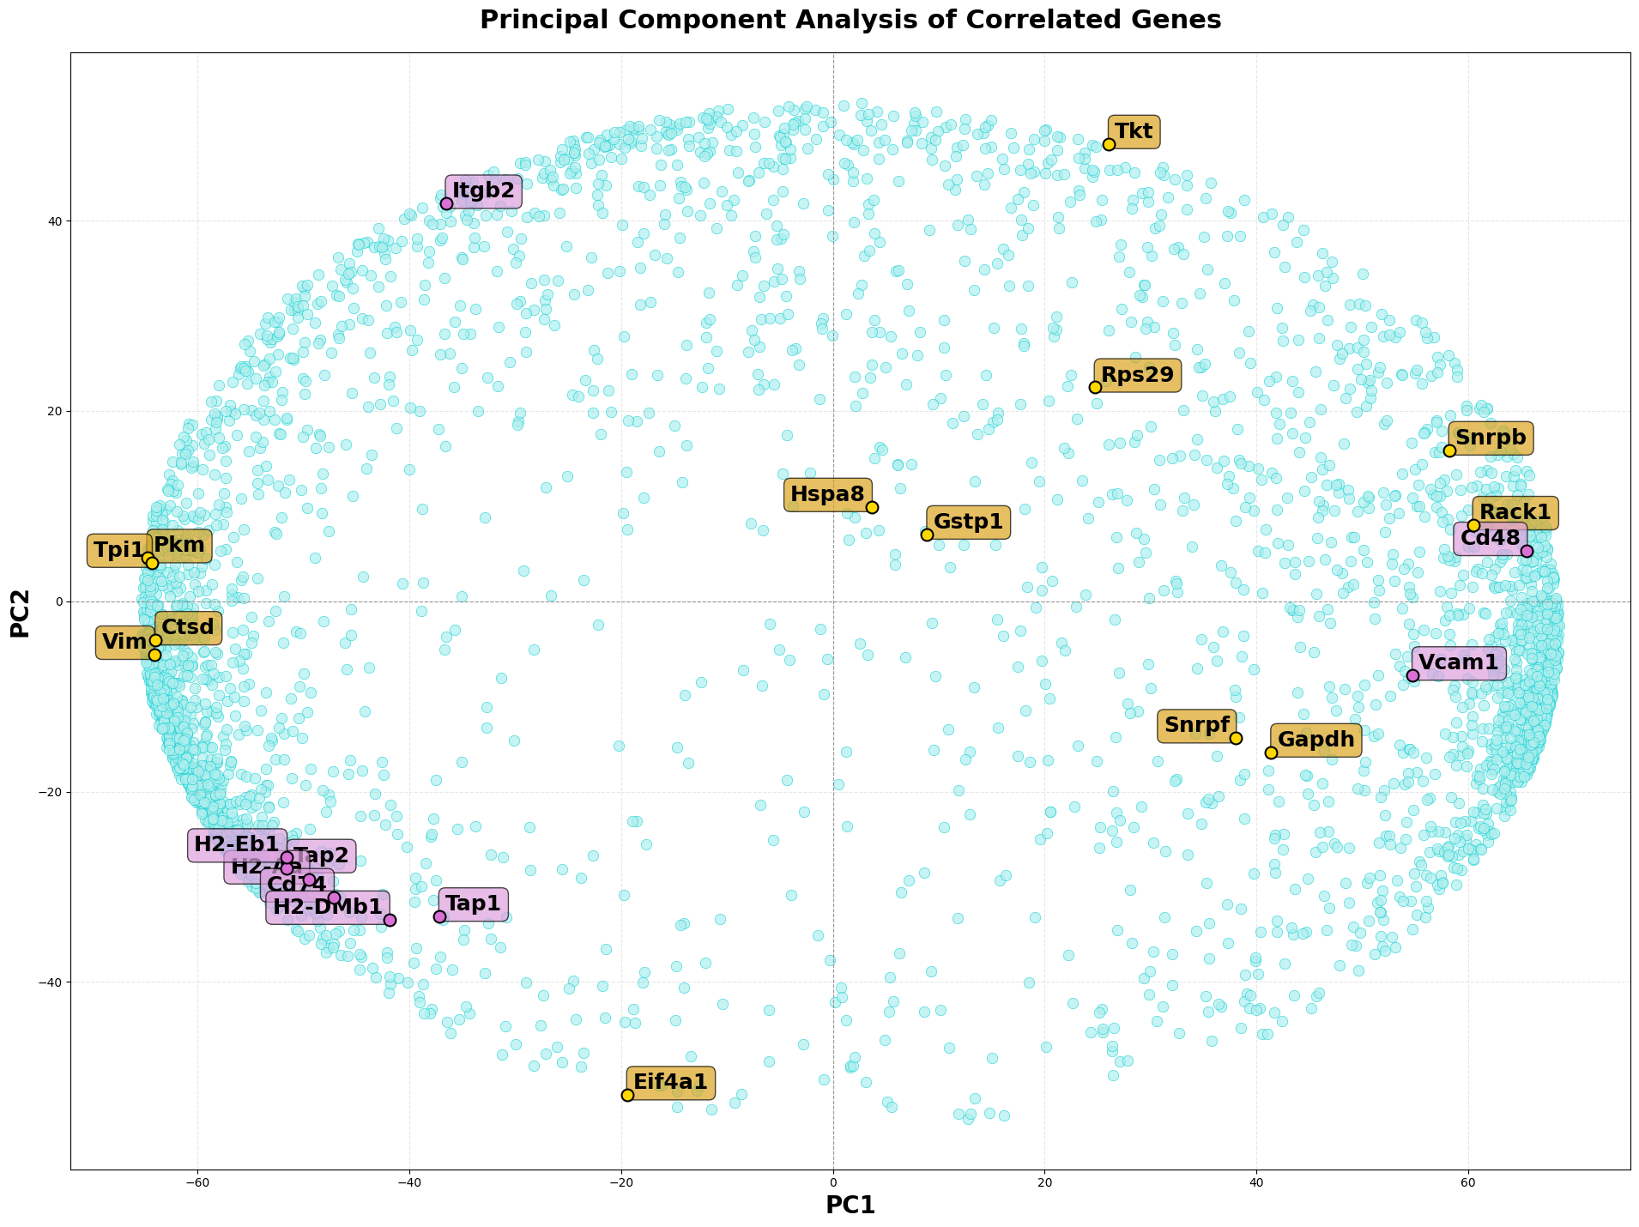
Do Antigen Processing Genes Correlate with our PDADP genes?
Principal Component Analysis of PDADP and Antigen Processing Genes
PC1: 69.04%
PC2: 28.10%
Total: 97.14%
Inclusion of antigen processing genes (APGs) reveals strong clustering of majority of APGs.
Some PDADPs show greater correlation with poorly clustered APGs (Cd48, Vcam1).
Jax BDSiC 2026

Slide 18
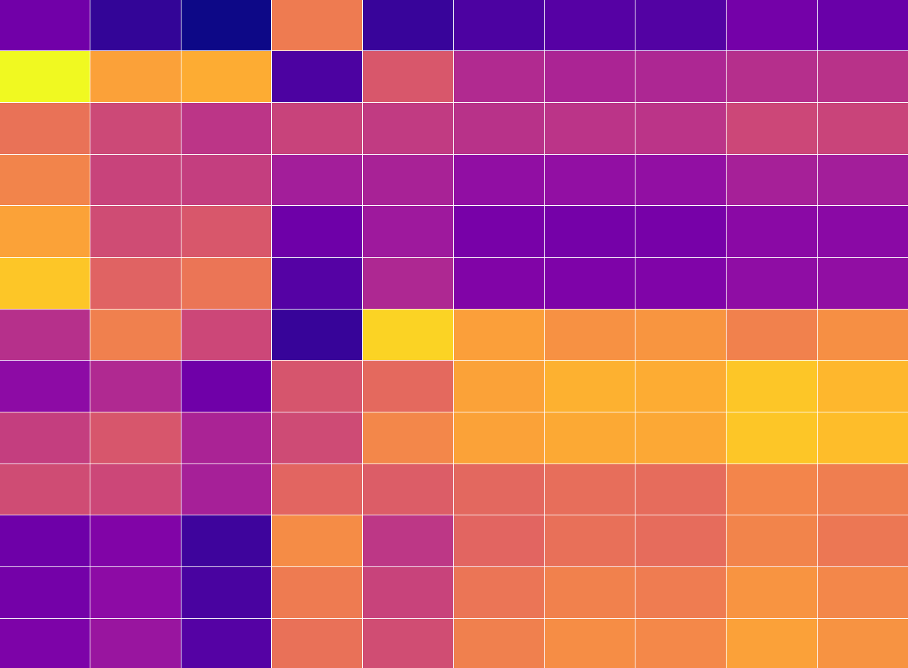
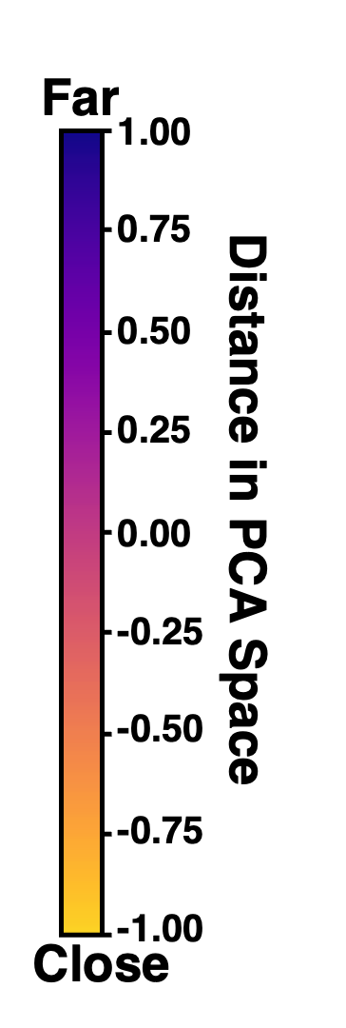
PDADP Gene Clusters Correlate with APGs Differently
Tkt
Snrpf
Heatmap analysis of distances between PDADPs and APGs reveal cluster dependent correlation.
Gapdh
Rps29
Rack1
Snrpb
Cluster 1 genes coexpressed with APGs
Eif4a1
Ctsd
Hspa8
Cluster 2 genes do not.
Gstp1
Pkm
Tpi1
Vim
CD48
Itgb2
Tap1
Cd74
Tap2
H1-DMb2
H2-Eb1
H2-Aa
Vcam1
H2-DMb1
Jax BDSiC 2026

Slide 19
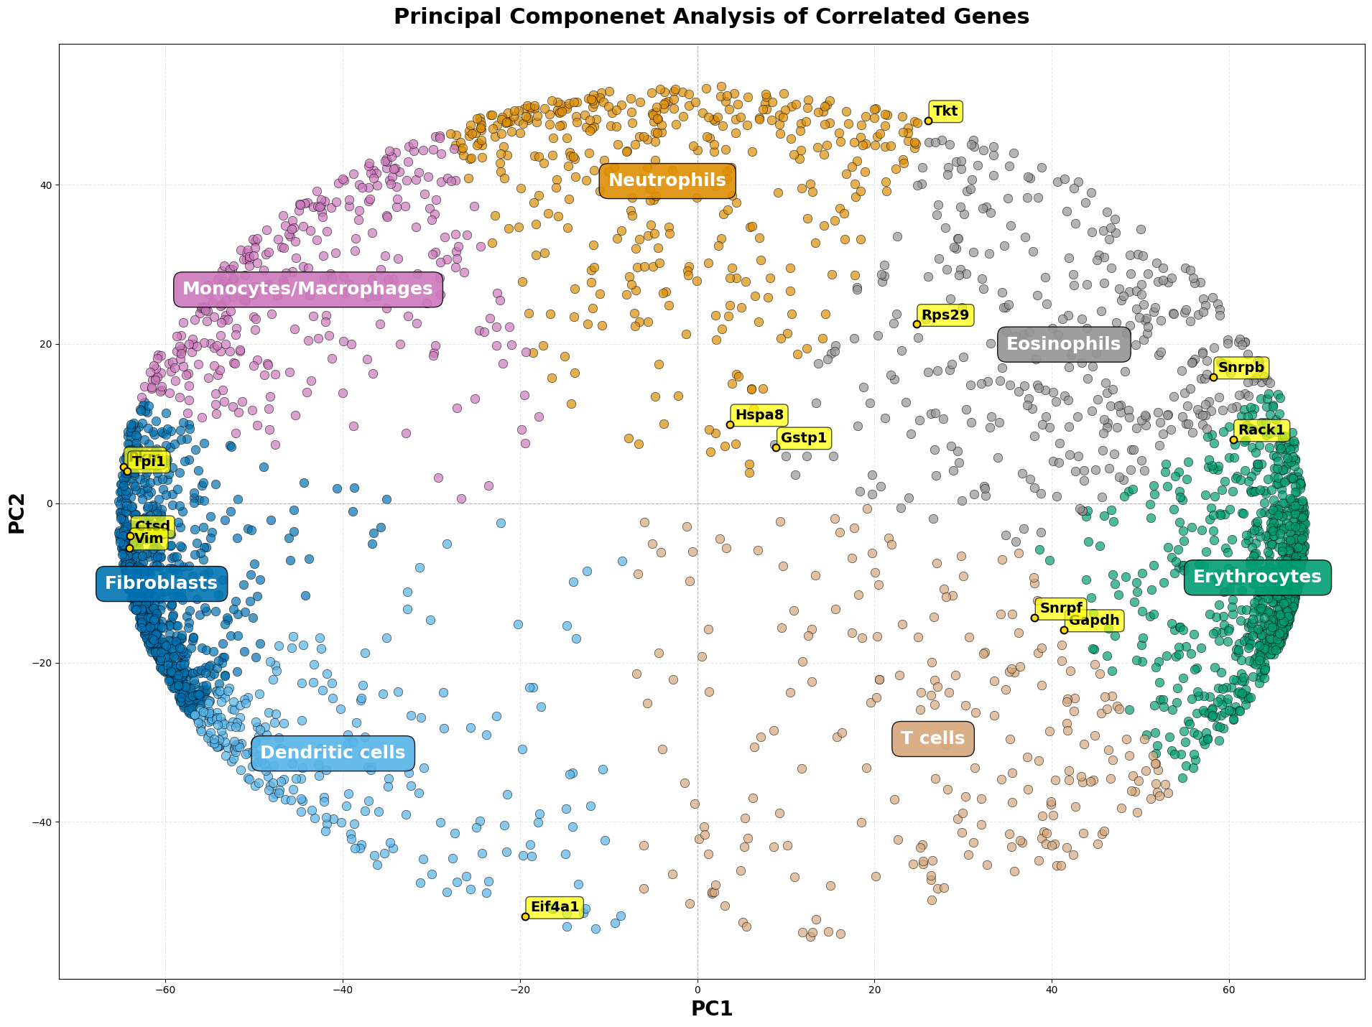
Do PDADP Genes Show Cell Type Specificity?
Cell Type Clustering of PDADP Genes
PC1: 69.04%
PC2: 28.10%
Total: 97.14%
To understand whether PDADPs show cell type specificity, deconvolution, genes were clustered and categorized based on known gene markers.
Only one PDADP (Eif4a1: cluster 1) is within a predicted APC cluster (Dendritic cells).
Jax BDSiC 2026

Slide 20
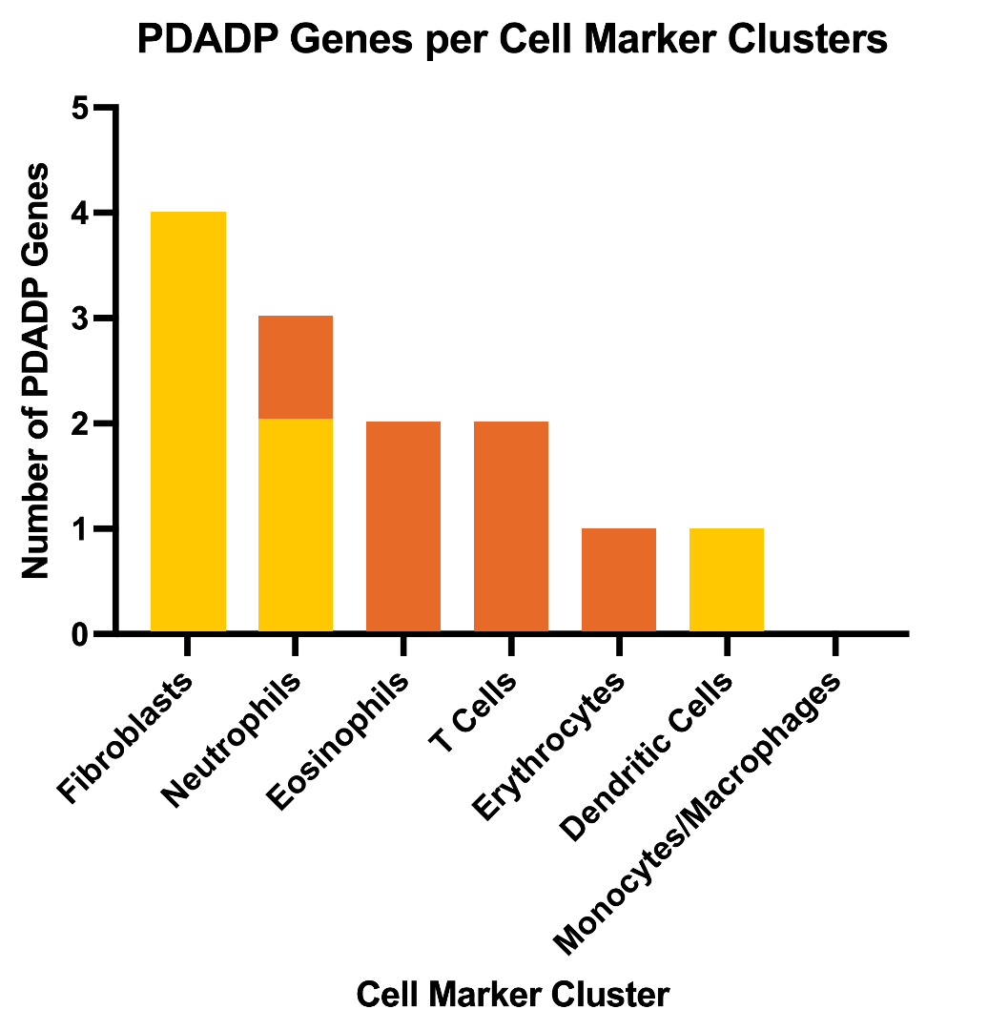
Do PDADP Gene Clusters Show Cell Type Specificity?
Quantification of PDADP Genes per clusters, based on PCA analysis.
Fibroblasts and Dendritic cells show cluster 1 bias.
Eosinophils, T cells, and Erythrocytes show cluster 2 bias.
Neutrophils display both cluster 1 and 2 PDAPs.
PDADPs were found in Monocytes / Macrophages, the most prevalent APC.
Cluster 1 PDADPs
Cluster 2 PDADPs
Jax BDSiC 2026

Slide 21
Discussion and Conclusions
PDADP genes are expressed in our Bullk RNAseq bone marrow dataset.
PDADP genes are not upregulated in immune cells during infection.
Two clusters of PDADPs show differential correlation with bone marrow genes.
PDADP clusters show different correlation with antigen presenting genes in PCA analysis.
PDADP clusters show cell type specificity based on deconvolution analysis.
Jax BDSiC 2026

Slide 22
Future Directions
To validate deconvolution and gain greater granularity in expression data, single cell RNA-seq databases are planned to be analysed for PDADP gene expression.
As analysis of PDADP production requires analysis of protein cleavage into peptides, not readily identifiable through transcriptomic analysis, we plan to reanalyze immune proteomics datasets to identify potential PDADPs in immune cells.
Jax BDSiC 2026

Slide 23
Acknowledgements
Danielle Presgraves, Ph.D.
Director, Data Science Training, The Jackson Laboratory
Seamus Mawe
Research Data Analyst I, The Jackson Laboratory
Daniel Gatti, Ph.D.
Senior Computational Scientist, The Jackson Laboratory
Laura Muller, Ph.D.
Director, Undergraduate and STEM Education, The Jackson Laboratory
Tuan Nguyen
Predoctoral Staff, The Jackson Laboratory
Matt Mahoney
Principal Computational Scientist, The Jackson Laboratory
Figures made with assistance of Biorender

Slide 24

Acknowledgements
Morgan Sanders
Program Assistant for Undergraduate and Graduate Programs, The Jackson Laboratory
Charlie Wray
Vice President for Education, The Jackson Laboratory
Ella von Dohlen & Sam Bigalke
Resident Advisors, Jax BDSiC 2026
Jax BDSiC 2026 Winter Cohort
Ryusuke Jono! & Carlos
Funding Provided by:
Tucker Taft and Phyllis Yale 🩷
The Jackson Laboratory 🩵
Jax BDSiC 2026

Slide 25
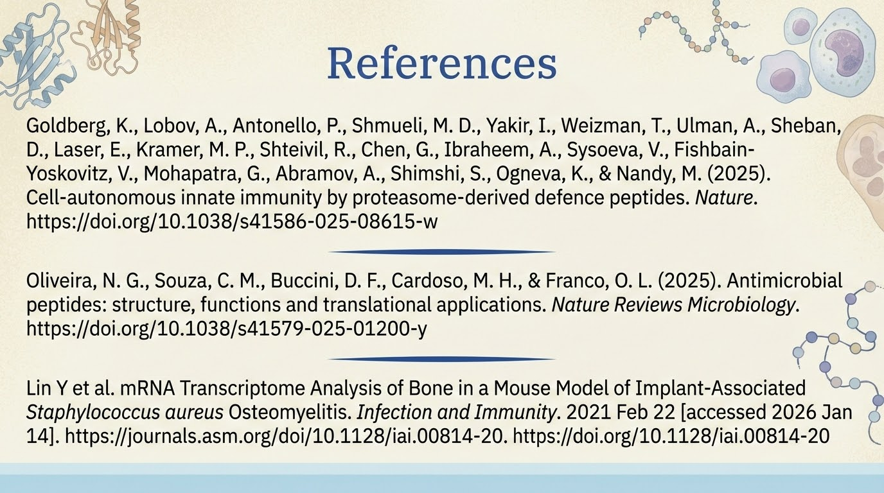
Jax BDSiC 2026

Slide 26
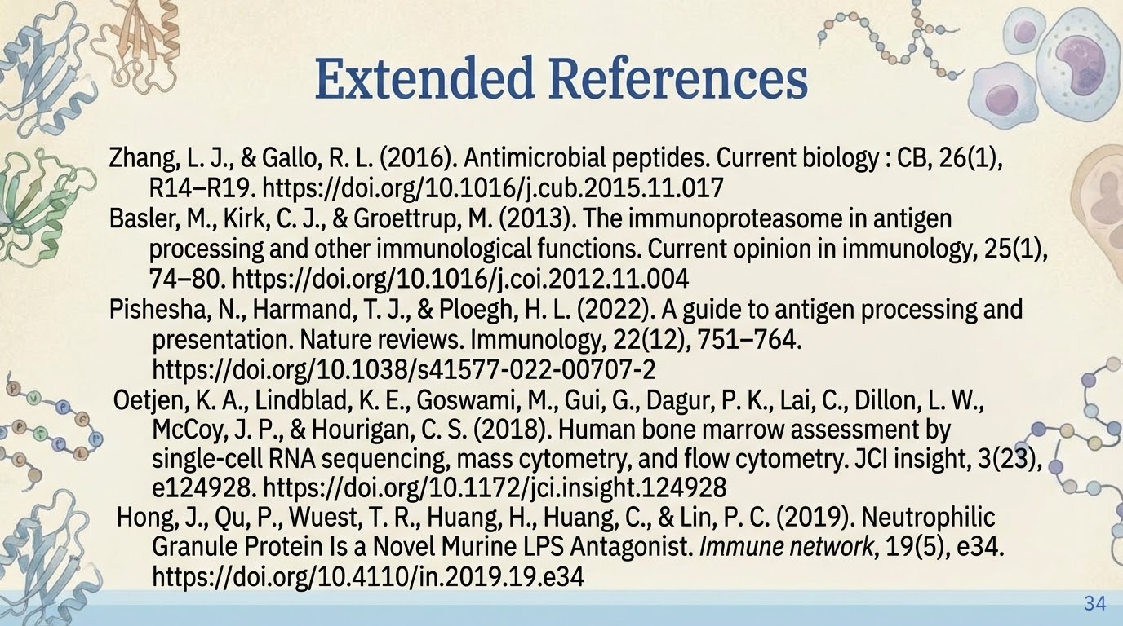
Jax BDSiC 2026

